Slide 1














Salary Prediction of
Data Professions
Presented by Maria Mohamed

Slide 2

INTRODUCTION:
Welcome to the presentation on "Salary Prediction of Data Professionals.”
Focus: - This project centers around analyzing factors influencing salaries in data professions.
Experience: - Throughout this project, we've gained insights into data exploration, feature engineering, and machine learning model development.
Goal: - Our goal is to develop accurate models that predict salaries based on various factors such as experience, job role, and performance ratings.

Slide 3
Data overview:
columns:
first name, last name, Doj, Sex, CURRENT DATE, DESIGNATION, AGE, SALARY, UNIT, LEAVES USED, LEAVES REMAINING, RATINGS, PAST EXP
Target variable:
SALARY

Slide 4
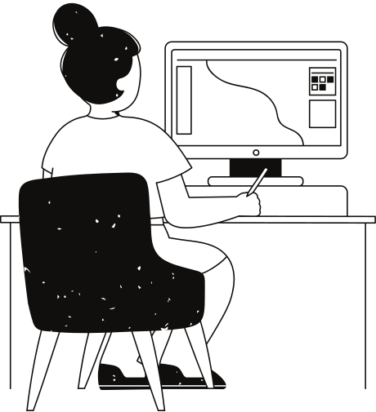
Exploratory Data Analysis
(EDA)
Conducted thorough analysis of the dataset.
Unveiled insights about data professionals' salaries.
Utilized data visualization and summary statistics.
Identified patterns and trends in the data.

Slide 5
Feature Engineering
Label Encoding for Categorical Variable (SEX):
Utilized LabelEncoder to convert the categorical variable 'SEX' into numerical representation.
Transformed 'SEX' into binary values (0 for Female, 1 for Male).
Standard Scaling for Numerical Variables:
Implemented StandardScaler to standardize numerical features.
Ensured all numerical features have a mean of 0 and a standard deviation of 1.

Slide 6

Data preprocessing:
prepare data for model training.
Handle missing values, encode categorical variables, scale/Normalize feature

Slide 7

Model Training:
Training a Linear Regression Model:
Developed a Linear Regression model within a Pipeline.
Utilized Linear Regression algorithm for predicting salaries based on various features.
Integrated preprocessing steps seamlessly into the model training process.
Chose Linear Regression due to its simplicity and interpretability.
Model Development
Data Splitting:
Model Evaluation:
Segmented the dataset into features (X) and target variable (y).
Utilized evaluation metrics such as:
Mean Absolute Error (MAE)
Mean Squared Error (MSE)
and R-squared (R2)
to assess model performance.
Utilized the train_test_split function to create training and testing sets with a 80:20 ratio.

Slide 8
Recommendations:
provide actionable insights based on finding.
Factors influencing salaries and Strategies to improve earnings.

Slide 9

conclusion:
summury of the project.
skills gained and impact on the job market.

Slide 10
Thank you

